Slide 1
Confidentiality protection and physical safeguards
Lars Vilhuber
Cornell University
Funding acknowledged under NSF-#1131848 (NCRN) and a grant from the Alfred P. Sloan Foundation

Slide 2
context of my talk today
Focus on researcher access to authorized microdata collections of federal statistical data
But private collections face similar issues and use similar mechanisms
Focus on the mechanisms for providing access
Mostly physical access controls
Role of disclosure avoidance mechanisms
Highlight the roles of “community”
Training
Legal framework
Role of institutions
Notes:
While the focus is not on building new data collections, the ability to protect existing data obviously has an impact on new data collections (see IMI,

Slide 3
publication trade-offs
Tabulations
Tabulations
Public-use microdata
Raw microdata
Ease of access
Privacy loss
← Loss of detail
Notes:
What will frame the analysis is the tension between undesirable (possibly illegal) publication of raw microdata, and the accessibility to a broader public of information on the contents of that raw microdata. The by now traditional solution was the publication of public-use microdata, using a variety of methods I won’t be discussing here.

Slide 4
The goal of data access
How to provide easy and convenient access to data with more detail than public-use microdata, less privacy loss than direct publication of raw data?

Slide 5
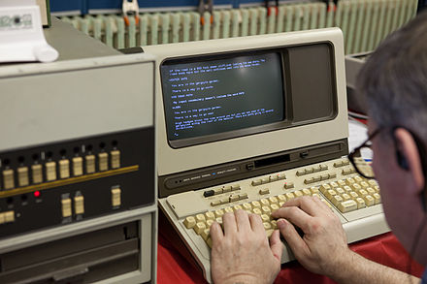


public use data
Data provider/ custodian
Data user/ researcher
Notes:
Back in the old days, convenience for public-use data meant that the data provider provided the data directly to the researcher.

Slide 6


confidential data
What type of access device?
What type of person?
?
Where is the data?
What type of room?
How do results leave the room?
Notes:
When facing the need to provide access to confidential data, the approach has been to put the researcher into a closed room. Questions then arising, and which I will talk about, involve defining the type of room, the type of computer used to access the data, the location of the data itself, who has the rights to access the data, and how results leave the room.

Slide 7
basic paradigm
“Data Enclave” or “Secure Room”
Where is the data?
What type of room?
Notes:
For instance, if the data provider ships the data directly to the secure room, we call it a “data enclave” or a “secure room”

Slide 8
the ideal
“My laptop”
“Data Enclave” or “Secure Room”
What type of access device?
Where is the data?
What type of room?
Notes:
From a physical point of view, not the best way to distribute data (loss of laptop…)

Slide 9
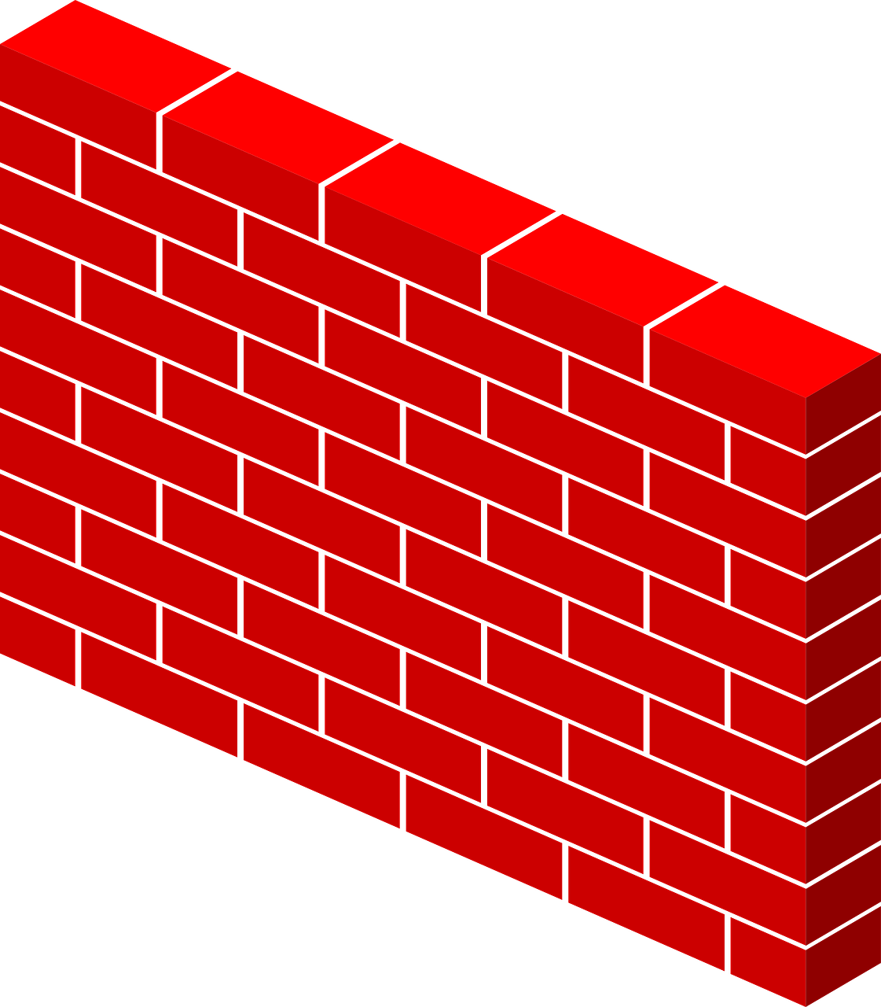
making things virtual
“Virtual Data Enclave”
What type of access device?
Where is the data?
What type of room?
Notes:
If on the other hand, the data provider retains custody of the data, and provides a remote access to the data through a firewall, we have virtualized the data enclave: the data enclave no longer physically houses the data. We may still walk into a well-defined space – a RDC – but as we will see, that is not always the case.

Slide 10
virtual data enclaves
Synonyms:
VDI
(virtual desktop infrastructure)
Thin clients
Remote desktop

Slide 11
Examples in 1990s
Physical data enclaves
Virtual data enclaves
(data remains in secure data center)
BLS HQ
BJS data access
Department of Education data
Census Bureau RDCs
Canadian RDCs
HRS restricted-access data
and many more
Notes:
Physical data enclaves were widely used in the 1990s, when direct provision of the data to end users was not feasible, including at the pioneering Census and Canadian RDCs

Slide 12
Examples in 2017
Physical data enclaves
Virtual data enclaves
(data remains in secure data center)
BLS HQ ?
BJS data access
Department of Education data
Census Bureau RDCs
Canadian RDCs
HRS restricted-access data
and many more
Census Bureau/Federal Statistical RDCs (since early 2000s)
German IAB RDCs (since mid 2000s)
French CASD (since late 2000s)
Cornell’s CRADC, NORC (early 2000s)
HRS restricted access data (2015)
and many many more
Notes:
In 2017, some of these have switched to a virtual data enclave structure, most prominent among them the Census Bureau –now Federal Statistical RDCs. Others have been created since then, from scratch. Canadian RDC system is considering moving part of its infrastructure to Virtual Data Enclave/ Thin Client/ VDI architecture

Slide 13
basic levers
What type of access device?
What type of room?

Slide 14
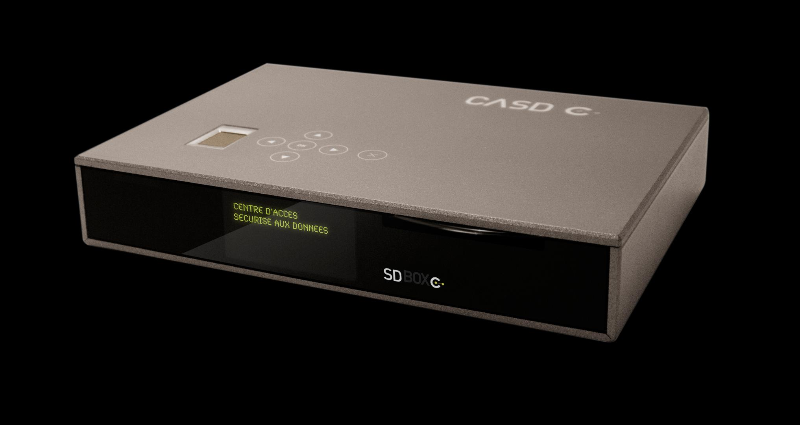

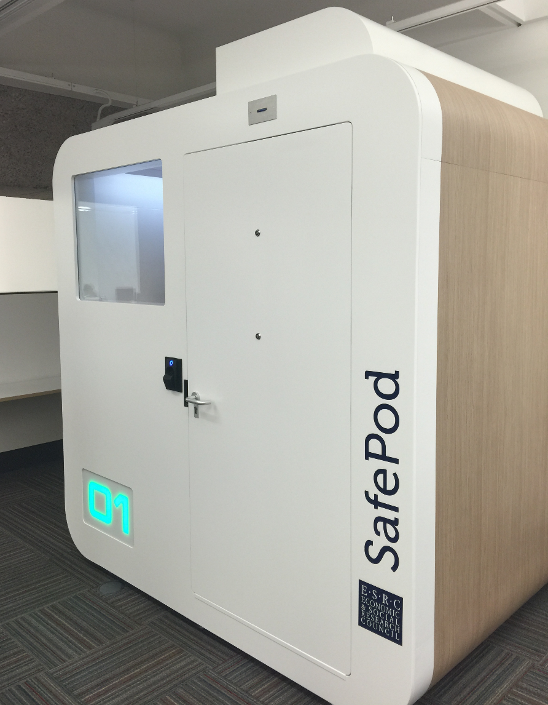
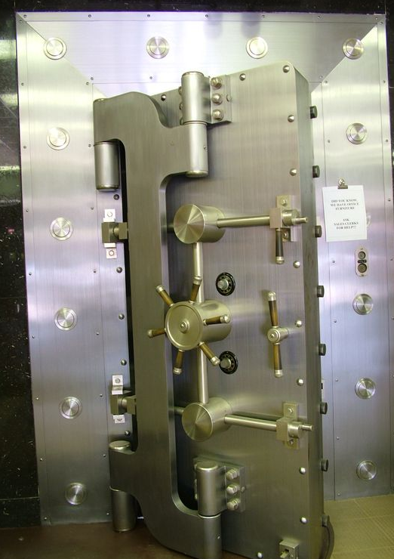
basic levers
Where?
How?
Notes:
The “where” and “how” of data access are the most obvious levers, ranging from complete freedom to Fort Knox-style security (the BJS HQ data center has been described to me like that). Relaxing the constraints on the where lead to RDCs or even location of thin clients in university offices.

Slide 15
access methods: enclaves
Tabulations
Tabulations
Public-use microdata
Ease of use
Privacy loss
RDC
Physically secure room housing access devices and/or data
← Loss of detail
Notes:
Mapping it back to the tradeoff between ease of use and loss of privacy, these systems tend to have similar loss of privacy – i.e., quite limited, but vary in the degress of ease of use.

Slide 16
access methods: enclaves
Tabulations
Tabulations
Public-use microdata
Software on your own PC giving a view onto secure data environment
Remote desktop
Ease of use
Thin client
Secondary secure PC giving a view onto secure data environment
Remote execution
Submitting analysis programs by email or through website (possibly combined with synthetic microdata)
RDC
← Loss of detail

Slide 17
What type of room?

Slide 18
Access matrix for confidential data
Control by data provider of:
 | # access points | Access computers | Access rooms | Avail. analysis methods | Type disclosure avoidance
FSRDC researcher | 24 sites (~700 users) | Full | Full (badge access) | Some (choice of software) | Manual/ variety of rules
Census staff researcher | n.d. | None (VDI) | None (VDI) | Some (choice of software) | Manual/ self/ variety of rules
IAB: JoSuA researcher | 414 users | None (Web application) | None (Web application) | Smaller (software, whitelist commands) | Manual/ variety of rules
CASD researcher | 371 sites (1471 users) | Extra Full (custom-built hardware) | Some (university office, EU) | Some (choice of software) | Manual/ variety of rules €300/ pack of 10
Stat.Denmark (typical EU) | ? | None (VDI) - Some (host institution) | None (VDI) -Some (host institution) | Some (choice of software) | Manual/ self/ variety of rules
Notes:
How can the broad network of CASD terminals (spread out across 300+ locations), the quasi-employee type of access in the Danish system be maintained?

Slide 19
How do results leave the room?
Notes:
As it turns out, there is surprisingly little variation in most of these systems in terms of the disclosure avoidance methods.

Slide 20
How do results leave the room?
Typically, the researcher asks an authorized agent of the data provider to review the results for risks of disclosure, and he will then send them to the researcher

Slide 21
What if the “authorized agent” were the researcher?
Notes:
So what if …

Slide 22
self-controlled release of results
Researcher controls release of results
Prepares results herself
According to certain prescribed rules
Sends them through a system
Automatically receives results typically per email
Used
Most often by contractually-controlled non-enclave data
Data in some university- or faculty-controlled enclaves (HRS, Dept. of Ed)
Danish researcher access system
Notes:
In this case, the researcher has control over the speed and timing of releases, while the agency still controls the rules. This is most often used when data are sent directly to the user or a university data enclave, where final control by the data provider is difficult or impossible. But it is also – radically? – used by the Danish system.

Slide 23
access methods: enclaves with researcher-controlled release
Tabulations
Tabulations
Public-use microdata
Self-controlled release
Raw microdata
Remote desktop
Ease of use
Thin client
Remote execution
RDC
← Loss of detail

Slide 24
access methods: enclaves with researcher-controlled release
Tabulations
Tabulations
Public-use microdata
Raw microdata
Remote desktop
Ease of use
Thin client
Self-controlled release
Remote execution
RDC
← Loss of detail

Slide 25
Access matrix for confidential data
Control by data provider of:
 | # access points | Access computers | Access rooms | Avail. analysis methods | Type disclosure avoidance
FSRDC researcher | 24 sites (~700 users) | Full | Full (badge access) | Some (choice of software) | Manual/ variety of rules
Census staff researcher | n.d. | None (VDI) | None (VDI) | Some (choice of software) | Manual/ self/ variety of rules
IAB: JoSuA researcher | 414 users | None (Web application) | None (Web application) | Smaller (software, whitelist commands) | Manual/ variety of rules
CASD researcher | 371 sites (1471 users) | Extra Full (custom-built hardware) | Some (university office, EU) | Some (choice of software) | Manual/ variety of rules €300/ pack of 10
Stat.Denmark (typical EU) | ? | None (VDI) - Some (host institution) | None (VDI) -Some (host institution) | Some (choice of software) | Manual/ self/ variety of rules
Notes:
So do we think that this is a radical system? Note the simulataneous flexibility in the Danish system as to the type of computer and the location of the access. But as it turns out, such a system is already applied in the US case: it is the system that Census staff researchers are subjected too. That should lead us to consider why we trust certain people with a more open approach, and not others. Two topics come to mind: the penalties applied, and the culture.

Slide 26
penalties

Slide 27
penalties
FSRDC and federal employee:
federal prison sentence of up to five (5) years, a fine of up to $250,000, or both.
France:
prison sentence of up to one (1) year, a fine of up to €15,000, or both.
Notes:
Note that this cannot explain the difference within the US between staff researchers and FSRDC researchers – they face the same penalties in case of breach of confidentiality.
However, notice that the more liberal systems also have more lenient penalties. France – with the broadest network – has lower penalties (but still prison)

Slide 28
penalties
IAB:
Loss of data access for up to two (2) years for researcher and institution
Contractual penalty up to €60,000 paid by the institution
Denmark:
Researcher: Loss of data access for life, or up to three (3) years for “minor breaches”
Institution: Loss of access for a positive but limited (undefined) period
No financial or penal penalties
Of Note: the FSRDC contract explicitly excludes a responsibility of the university for the actions of its employees, though university remains bound by FWA/IRB.
Notes:
IAB and Denmark – binds the institution, not just the researcher. Germany (€60,000 ~ $67000 but increasing…) has no prison, and still relatively puny monetary penalties, but allows for transnational access.

Slide 29
penalties
Does ease of application matter (penal vs. contractual rules)?
Is it conducive to more strongly engage the researcher’s employer (typically but not exclusively a university)?

Slide 30
trust and access

Slide 31
What type of person?
Notes:
Which addresses the question of “what type of person”

Slide 32
trust and access
Frequent discussion
Security measures are for (malevolent) intruders/opponents
Researchers are trusted collaborators…
… who know what they are doing
A corollary:
Protect against the bad guys
But let the “good” guys do their thing
Examples:
Network-moderated access
Contracts with disclosure avoidance rules
How do you know who the good guys are?
Also known as the “old boys’ network”

Slide 33
hypothesis: culture matters
Researchers and agencies create the communities in which rules are applied and enforced
Training and “indoctrination”:
Training of FSRDC researchers (short, decentralized) vs. FedStat employees (≥1 day on-site)
1 full day on-site (in Paris) training for French researchers
Common forums:
Conferences: Canadian, US (FSRDC, NCHS) yearly RDC conferences
Discussion, local groups: users of FSRDC share a common physical space
More or less tight binding of researchers into a community is important

Slide 34
training content, method, and frequency
 | Frequency | Access rules? | Disclosure rules? | Disclosure avoidance tools? | Method
FSRDC | yearly | Initial | As needed | No | Online
IAB RDC | Initial | Initial | Yes | No | PDF (Contract, other)
CASD (France) | Initial | Initial | Yes | No | In person (3h)
Denmark | Initial | Yes | No | No | PDF (Contract)
Notes:
Initial + PDF means that no formal training occurs; rather, the information is transmitted through a contract or initial set of materials

Slide 35
virtual enclave = centralization
Notes:
One final concern

Slide 36

Concerns about centralized compute infrastructure
Canada
Wayne Smith upon his resignation as Chief Statistician of Canada: “…this situation [transfer of IT to Shared Services Canada] has already led to a progressive degradation of informatics infrastructure support with significant consequences for our effectiveness, our budget and our program.” (Ottawa Citizen, Sept. 16, 2016, http://ottawacitizen.com/news/local-news/canadas-chief-statistician-quits-statistic-canada )
Continuing concerns amongst the Canadian RDCs about a central government-run IT infrastructure

Slide 37
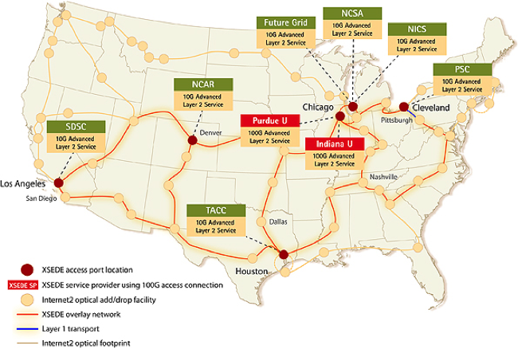
Concerns about centralized compute infrastructure
Scope
FSRDC infrastructure dwarfed by other federal research investments (e.g. XSEDE) that cannot be utilized
Cluster | Cores | Tflops | As a multiple of FSRDC
FSRDC | 240 | 4.36 | 1x
Wrangler (TACC) | 2304 | 62 | 14x
Stampede (TACC) | 102400 | 9600 | 2202x
Notes:
Wrangler is the smallest listed system on XSEDE as of Feb 2017, Stampede is the largest. Information obtained from https://www.xsede.org/web/guest/resources/overview on Feb 18, 2017. FSRDC estimated based on 10 dual-CPU, 12core systems.

Slide 38
summary

Slide 39
summary
Remote access of some type is the standard practice around the world
Access locations and ease of releasing results vary substantially
Disclosure avoidance process is still quite pedestrian in almost all cases, and DA methods are “old-fashioned”. Self-release of data is the exception.

Slide 40
some concluding thoughts
How to enable a scalable and secure system
Does it require changes in the legal framework?
How to build a culture of responsible and secure data access among researchers?
What kind of devices or access mechanisms do we want to enable?
Who gets to hold the data that researchers actually access?

Slide 41

thank you
lars.vilhuber@cornell.edu

Slide 42
Supplementary slides

Slide 43
my geographic bias
Notes:
My experience has a certain Anglo-Saxon and European tint – I happen to have some experience and knowledge with the Brazilian case, but won’t reference that today.

Slide 44
3rd party data custodian
“Virtual Data Enclave”
Trusted 3rd party data center
Where is the data?
Data provider

Slide 45
historical background

Slide 46
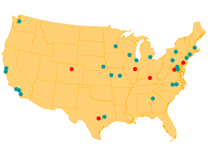

access to Census Bureau data
Starting in the 1960s and 70s, increased use of public-use microdata samples and surveys
Researcher access at Census Bureau headquarters in the 1970s
First RDC at Boston in the 1994
A small number of RDCs in the 1990s
Thin clients in the 2000s
2016: 24 RDCs
Expansion to include other federal data providers
Notes:
Note: there is also access to some private data in the FSRDC (Kauffman survey, compustat) but not primary

Slide 47
some other FedStats
BLS
Longtime only through HQ RDC
Now available through FSRDC
NSF, Department of Agriculture
Available through NORC
NCHS
Multiple access mechanisms, including HQ RDC, FSRDC, Remote processing system

Slide 48
other countries: Germany
Institute for Employment Research (IAB), Germany
Commission to improve the informational infrastructure between the scientific community and official statistics
recommended creation of RDCs by producers of microdata (2001)
RDC created in 2004 for “weakly anonymous” data
Scientific use files (factually anonymous data) available under licensing agreements to university data enclaves
2011 RDC created at University of Michigan (with NSF funding)
(KVI)
1902
1942
1960
1985
today
2001
2004
2011
15 RDCs in 3 countries
Notes:
I‘m only going to focus on a few other countries that demonstrate some of the features I want to highlight
Kommission zur Verbesserung der informationellen Infrastruktur zwischen Wissenschaft und Statistik, KVI

Slide 49
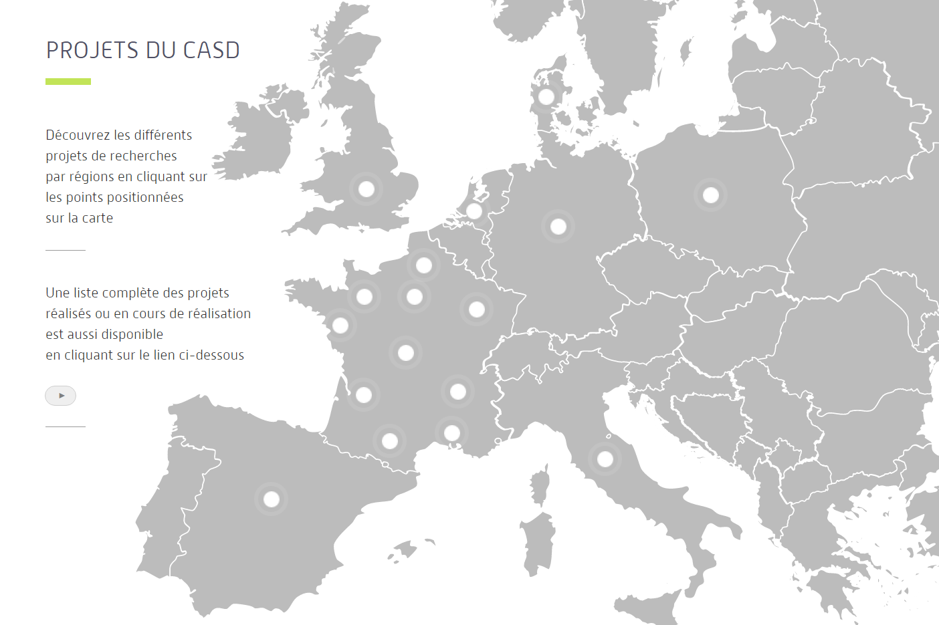
other countries: France
Centre d’accès securisé distant (CASD, France)
Note: within same agency that enabled AKM (1999)
INSEE recommended implementing a secure center for accessing data (2007)
2008 modification to Statistics Law made possible pilot infracstructure
Pilot infrastructure becomes permanent in 2009
Expansion with per-project cost (invoicing) in 2012
Loi Informatique et Libertés (1978)
1985
1995
2008
2012
today
1990
1st working group
2007
2009
371 APs in 8 countries
Source: presentation to the CASD Scientific Committee in 2013
Notes:
1990 census was a trigger, when increased demand hit stronger privacy protection – demographers and sociologists
CREST was the original privileged access holder to data, but a driver in making it a more public entity.

Slide 50
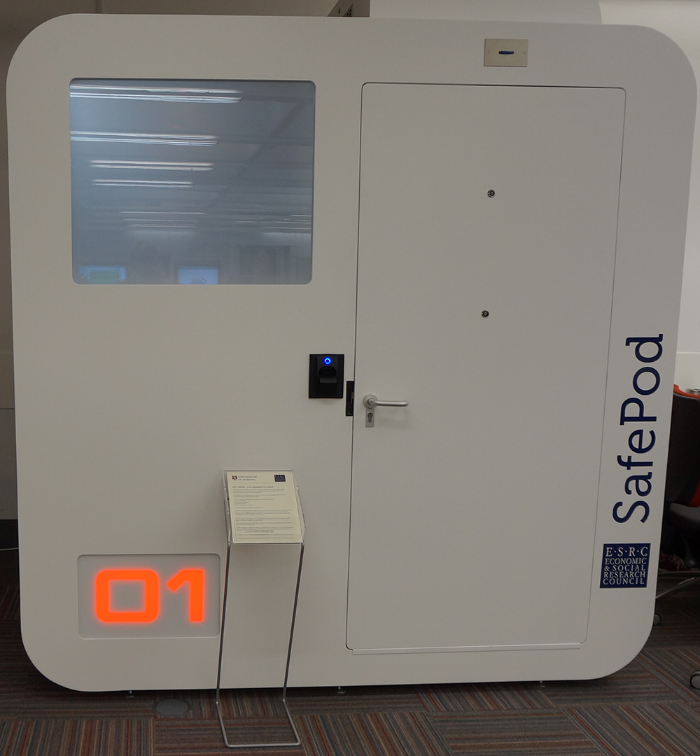
that spaceship thing…
Pre-fabricated secure room
First one installed in 2015 at University of St. Andrews (Scotland/UK)
2.3m x 1.8m
Electronic locking, biometric recognition, CCTV, “Smart Glass”
£ 25,000 ~ $30,000 incl. installation
Part of UK ADRN
[For now: EU]
(7’6” x 5’10”)
Source: http://libanswers.st-andrews.ac.uk/faq/93548

Slide 51
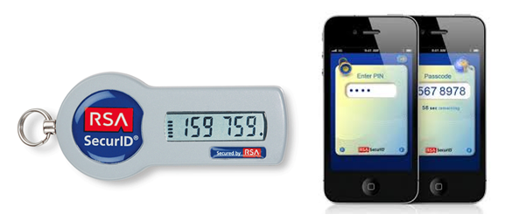


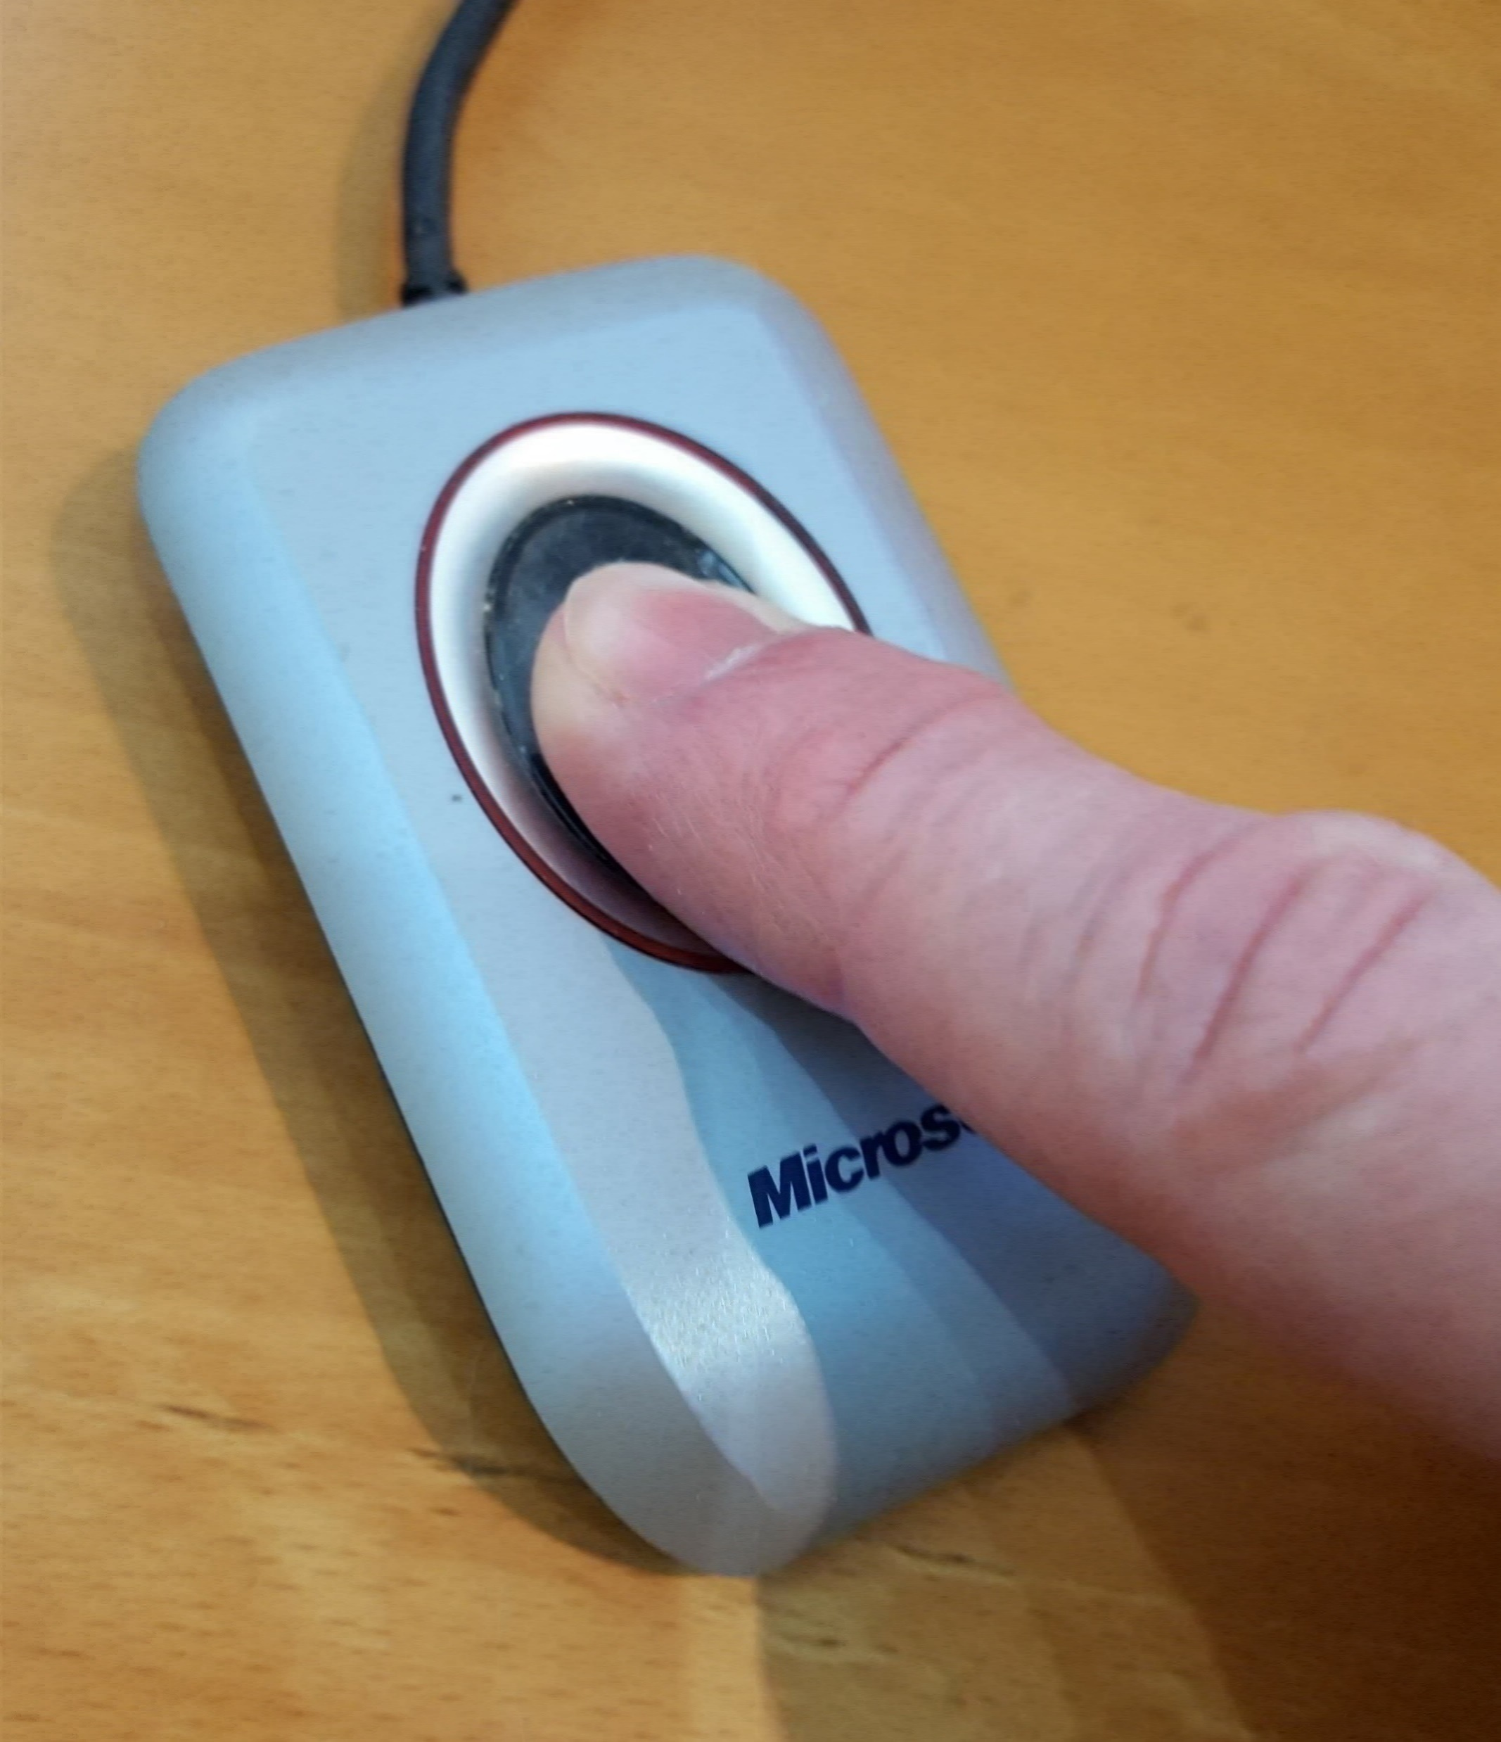
thin clients
With the notable exception of the Canadian RDCs (for now), thin clients are the preferred method of access
Surrounded by walls = RDC [FSRDC in US, Germany, others]
Embedded in a managed device = “thin client” [above, plus France]
Software with a managed access token = “remote desktop” or “VDI” [some US agencies; DK, Finland]
Additional controls may be
IP address control [many]
Biometric authentication [France]
Smart card [France, US]
70.48.127.42

Slide 52
that box thing
Custom remote access device used at CASD
Encrypted storage, biometric smartcard reader, pre-configured VPN
€35.00 / month, first user free, additional users €37.00 - €20.00 / month (decreasing)

Slide 53
scalability (CASD)
… added in 2016 alone
Totals
71 access points
232 users
62 projects
371 access points
1402 users
472 projects

Slide 54
full matrix of access controls

Slide 55
Access matrix for confidential data
Control of: | Data access | Analysis computers | Access computers | Access rooms | Analysis methods
FSRDC researcher | Full | Full | Full | Full (badge access) | Some (choice of software)
Census employee | Full | Full | None (VDI) | None (VDI) | Some (choice of software)
Control of: | Data access | Analysis computers | Access computers | Access rooms | Analysis methods
FSRDC researcher | Full | Full | Full | Full (badge access) | Some (choice of software)
Census employee | Full | Full | None (VDI) | None (VDI) | Some (choice of software)
IAB: RDC researcher | Full | Full | Full | Full (trusted person) | Some (choice of software)
IAB: JoSuA researcher | Full | Full | None (Web application) | None (Web application) | Smaller (software, whitelist commands)
Control of: | Data access | Analysis computers | Access computers | Access rooms | Analysis methods
FSRDC researcher | Full | Full | Full | Full (badge access) | Some (choice of software)
Census employee | Full | Full | None (VDI) | None (VDI) | Some (choice of software)
IAB: RDC researcher | Full | Full | Full | Full (trusted person) | Some (choice of software)
IAB: JoSuA researcher | Full | Full | None (Web application) | None (Web application) | Smaller (software, whitelist commands)
IAB employee | Full | Full | Full (IAB laptop) | None (VDI) | Some (choice of software)
Control of: | Data access | Analysis computers | Access computers | Access rooms | Analysis methods
FSRDC researcher | Full | Full | Full | Full (badge access) | Some (choice of software)
Census employee | Full | Full | None (VDI) | None (VDI) | Some (choice of software)
IAB: RDC researcher | Full | Full | Full | Full (trusted person) | Some (choice of software)
IAB: JoSuA researcher | Full | Full | None (Web application) | None (Web application) | Smaller (software, whitelist commands)
IAB employee | Full | Full | Full (IAB laptop) | None (VDI) | Some (choice of software)
CASD researcher | Full | Full | Extra Full (custom-built hardware) | Some (university office, EU) | Some (choice of software)
Control of: | Data access | Analysis computers | Access computers | Access rooms | Analysis methods

Slide 56
Access matrix for confidential data
Control of: | Data access | Analysis computers | Access computers | Access rooms | Analysis methods
FSRDC researcher | Full | Full | Full | Full (badge access) | Some (choice of software)
Stat.Denmark (typical EU) | Full | Full | None (VDI) - Some (host institution) | None (VDI) -Some (host institution) | Some (choice of software)
RDC Canada | Some (demog. only) | Some (host institution) | Some (host institution) | Full (badge access) | Some (choice of software)
Stat.Canada (typical of HQ) | Full (incl. business) | Full | Full | Full | Some (choice of software)
RDC Canada (thin client) | planned
Notes:
HQ also in Netherlands (drivable), replaced with Denmark-style VDI from university locations. HQ approach also in Brazil (Rio) – Instituto brasileiro da geografía e estatística. Canada: enclaves of StatCan within universities, owned and operated by universities, on university computers, under supervision and authorization of StatCan

Slide 57
remote tabulation

Slide 58
access methods: remote tabulation
Tabulations
Tabulations
Remote tabulation
Public-use microdata
Raw microdata
Remote desktop
Ease of use
Thin client
Remote execution
RDC
← Loss of detail

Slide 59



remote processing paradigm

Slide 60
remote processing paradigm

Slide 61
Access matrix for remote submission
Control of: | Access computers | Access rules | Analysis methods | Disclosure avoidance | Cost
CB: Synthetic data | Custom compute cluster | Simplified proposal | Any (SAS, R Stata, Matlab) | Manual/ traditional | $0
IAB: JoSuA researcher | Web application | Full proposal | Smaller (Stata, whitelist commands) | Manual/ traditional | $0
Australian TableBuilder | Web application | Registration | Tables only | Embedded/ tab. noise infusion | $0/ >$0
Canada RTRA | Upload through Web | Simplified proposal + license | Smaller (SAS, whitelist commands) | Automated controlled rounding | $0
NCHS | Upload through FTP | Full proposal | Smaller (SAS, whitelist commands) | Manual/ traditional | $750/mth
Control of: | Access computers | Access rules | Analysis methods | Disclosure avoidance | Cost
CB: MAS/AQS | Web application | None (?) | Smallest (whitelist commands) | Embedded/ various | $0
Control of: | Access computers | Access rules | Analysis methods | Disclosure avoidance | Cost
CB: Synthetic data | Custom compute cluster | Simplified proposal | Any (SAS, R Stata, Matlab) | Manual/ traditional | $0
Notes:
Synthetic data is NOT a remote submission system, but it is a access mechanism

Slide 62
The ultimate remote submission
Co-author with an employee of stats agency…
Notes:
(this is a joke)

Slide 63
remote access setup
Some setup required
IAB’s JoSuA starts with a regular “on-site” access
NCHS has a regular proposal process, billing is involved
StatCan’s RTRA has a proposal process, review, etc.
Testing in order to process remotely
Dummy or test files (IAB)
“Synthetic” files (StatCan)
Pre-defined data dictionaries (NCHS)

Slide 64
training

Slide 65
hidden element: how is Disclosure Avoidance done?
Most access methods:
Enforcing minimum count of entities in a statistic (coefficient, mean, stddev)
Prohibiting creation of tabular data (or making it very expensive)
(Vain) attempt at tracking overlapping releases
Automated systems
Tracking of cells, implementation of (randomized) rounding, suppression, (output) noise infusion (StatCan, ABS)
Similar in CB’s Microdata Analysis System/Automated Query System
Newer mechanisms
Noise infusion upon computation
Differentially-private output perturbation (of model-based statistics, incl. coefficients and expected counts)

Slide 66
hidden cost: how to train the users?
Programming
DP-safe programming is hard for computer scientists → lost cause with social scientists until incorporated into SAS, Stata, etc.
Tools
Mostly lacking (in all of the environments that I have experienced)
Concept
Researchers have a hard time understanding confidentiality constraints
Researchers have a hard time accepting confidentiality constraints

Slide 67
results from a survey of FSRDC users
Survey run in October 2015, 145 respondents

Slide 68
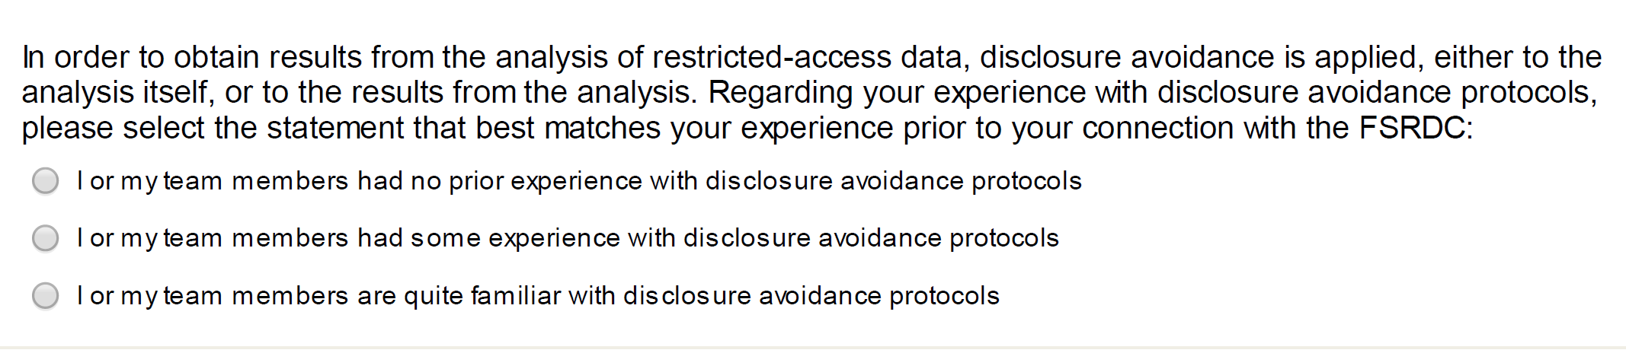
FSRDC user experience: DA protocols
39% no prior experience
30% some experience
31% quite familiar

Slide 69
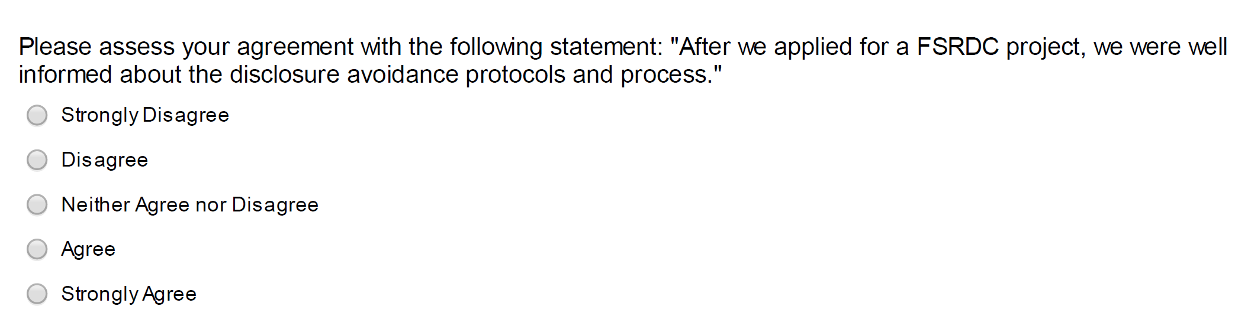
FSRDC user experience training
14% disagree or strongly disagree
73% agree or strongly agree
13% do neither

Slide 70
results from a survey of FSRDC users
Disclosure avoidance:
Users (NCHS) complained that “Disclosure avoidance personnel declined to approve output because they were not familiar with the software” despite pre-approval of generic output.
Other users grudgingly acknowledged that they “cannot avoid disclosure review” (on a NCHS project).

Slide 71
training content, method, and frequency
 | Frequency | Access rules? | Disclosure rules? | Disclosure avoidance tools? | Method
FSRDC | yearly | Initial | As needed | No | Online
IAB RDC | Initial | Initial | Yes | No | PDF (Contract, other)
CASD (France) | Initial | Initial | Yes | No | In person (3h)
Denmark | Initial | Yes | No | No | PDF (Contract)
Notes:
Initial + PDF means that no formal training occurs; rather, the information is transmitted through a contract or initial set of materials

Slide 72
Responsible Conduct of Research (RCR)
Course Introduction
Research Misconduct
Research Involving Human Subjects
Plagiarism
Authorship
Collaborative Research
Conflicts of Interest
Data Management
Mentoring
Peer Review
Approximately 3 hours
Note: No discussion of practical disclosure avoidance, etc.

Slide 73
French training
One-time initial training
3 (three) hours on-site classroom training
Travel to Paris required
First slide: legal penalties
Quarter of slides: disclosure rules
Mostly cell-count rules
Mostly (numeric) examples of primary/secondary suppression
Examples of what confidential supplementary files should look like
Half of slides: technical system with live demo

Slide 74
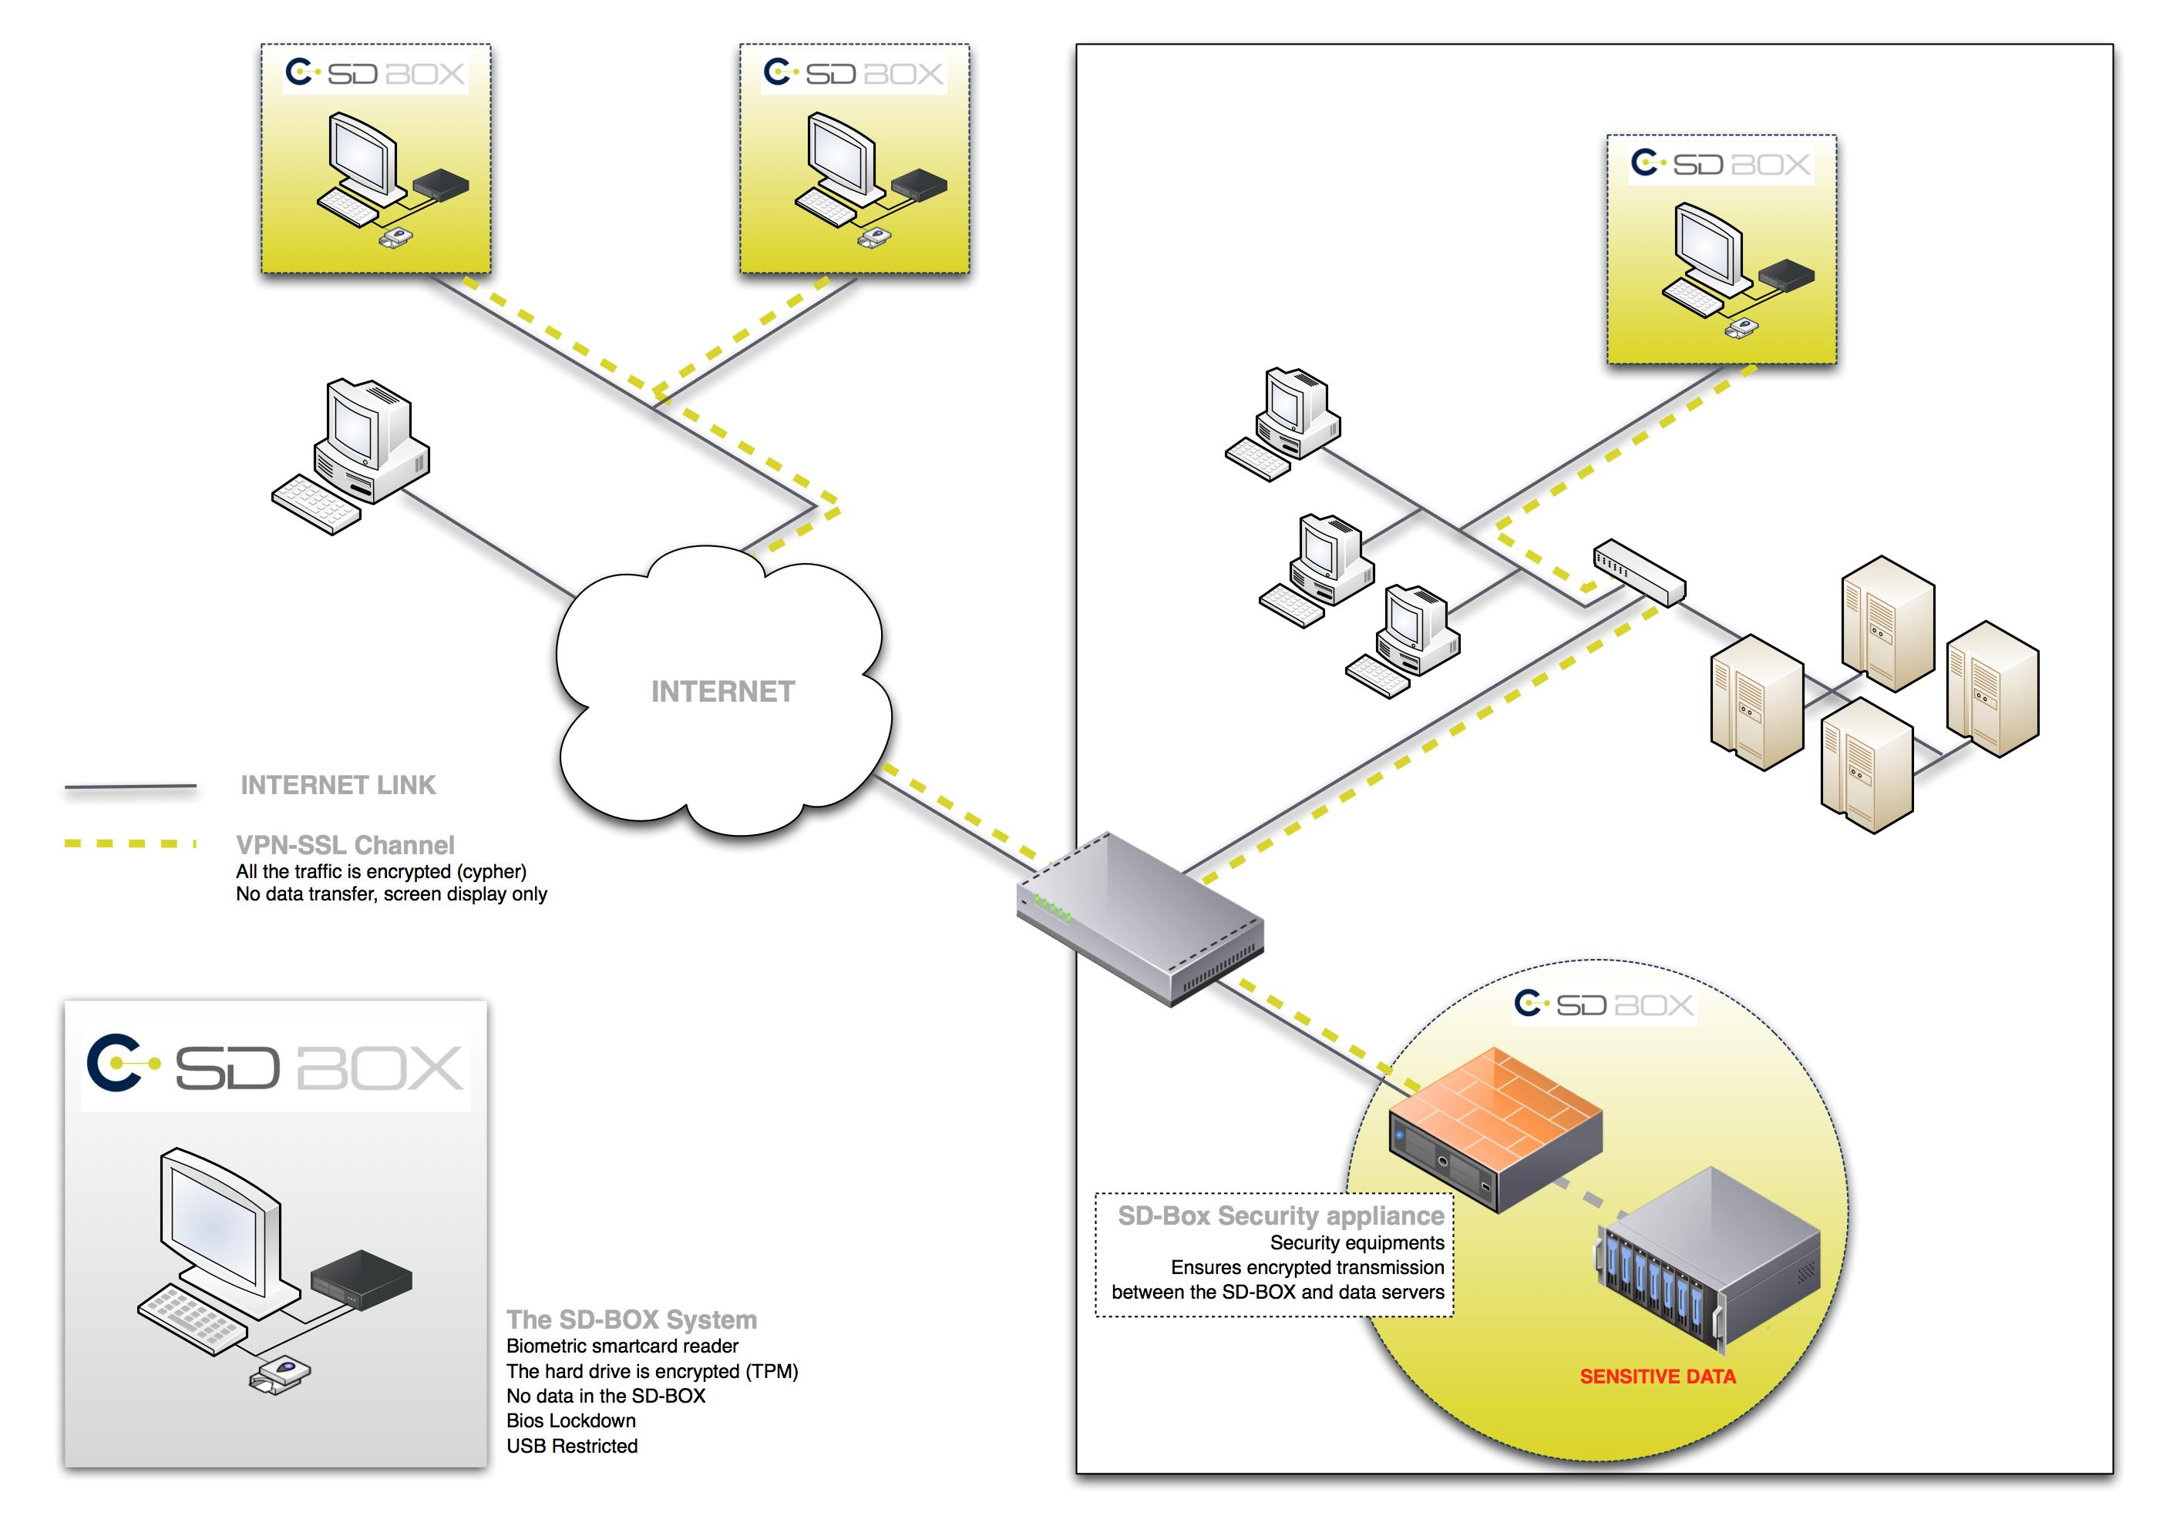
CASD setup
Source: CASD training materials 2017-01-12
Notes:
Researchers get shown the idea behind the infrastructure through this graph

Slide 75
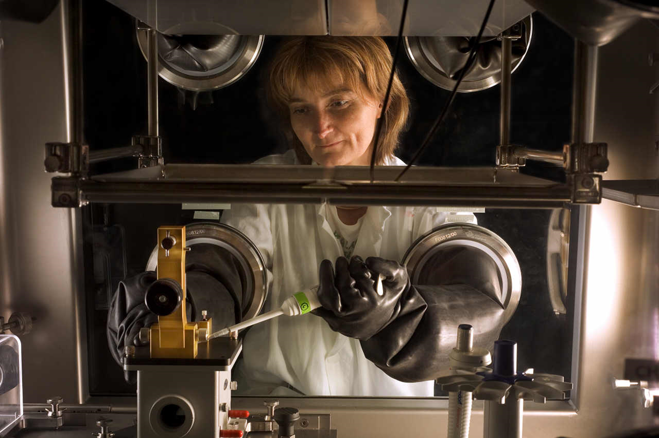
CASD setup
Source: CASD training materials 2017-01-12
Notes:
And are provided this picture of how they should consider the manipulation of data that they are performing.

Slide 76
CASD security
Four-factor authentication
Device
Card
Fingerprint
Password
Loss of card (+fingerprint data) → trip back to Paris to create a new one

Slide 77
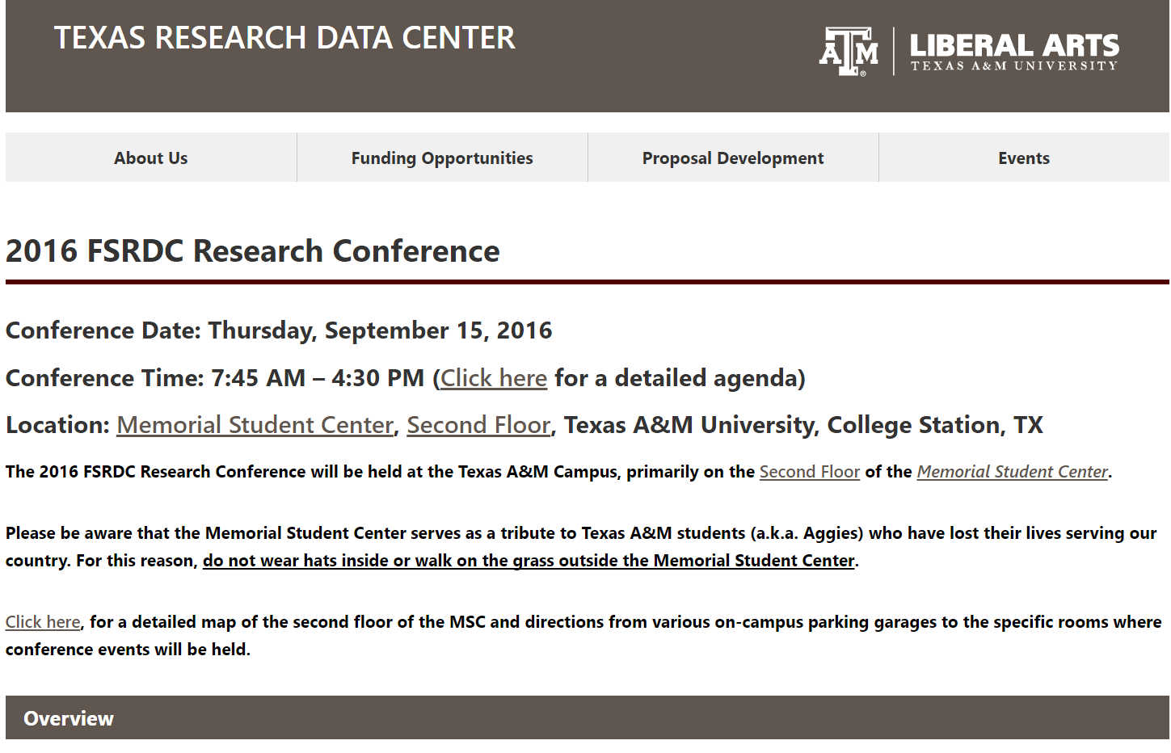
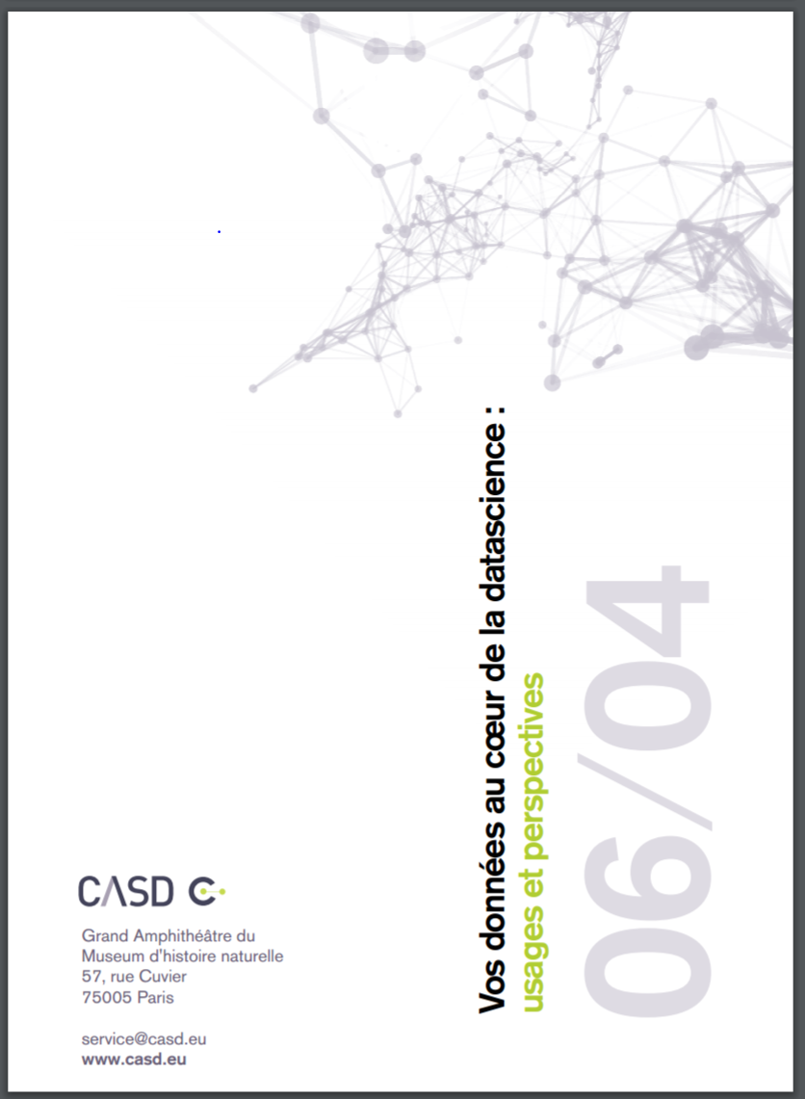
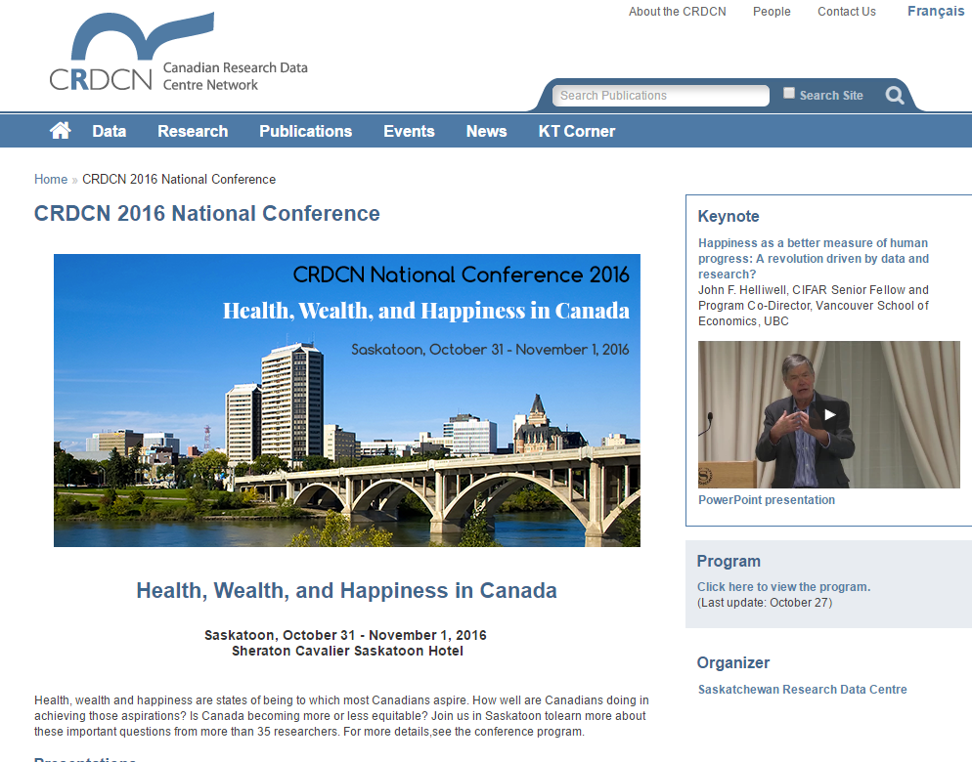
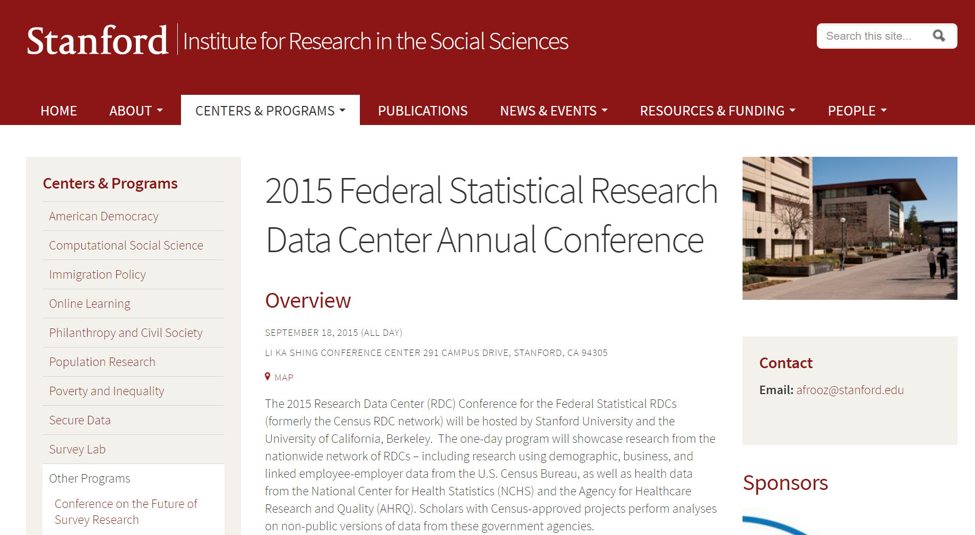
conferences
Notes:
Conferences are a key community-building tool, and the US and Canadian systems have long histories of holding such data-user oriented conferences (less so in Europe). [Image of Canadian RDC conference added after presentation]

Slide 78
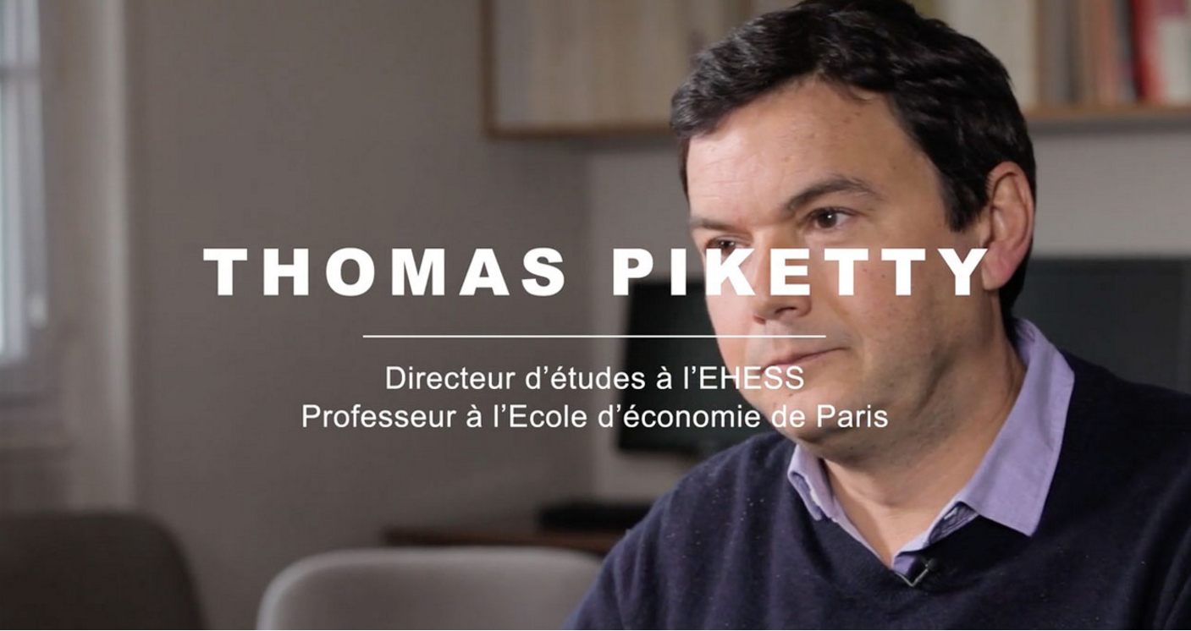
community
Census Bureau
CES seminars featuring FSRDC presenters
CES graduate mentorship
FSRDC conference
CASD
Initial training plays a role
So far, only one conference, but very high-profile
Piketty video [URL]
Minister of State for Digital Affairs Axelle Lemaire
Notes:
Axelle Lemaire (“minister of state” equivalent to undersecretary) – FSRDC has had the Under Secretary of Commerce for Economic Affairs (Mark Doms)

Slide 79
community (cont.)
IAB
(past) visits to Nürnberg suggested and funded to connect with researchers
So far, one international conference (at Michigan, organized by Maggie Levenstein)
Overseas RDCs are a community-building exercise
Flooding the job market with economics graduates who have worked with German data…

Slide 80
training content, method, and frequency
 | Frequency | Access rules? | Disclosure rules? | Disclosure avoidance tools? | Method
FSRDC | yearly | General (+ site specific) | General | No | Online
IAB RDC | Initial | No | Yes | No | PDF (Contract, other)
CASD (France) | Initial | Yes | Yes | No | In person (3h)
Denmark | Initial | Yes | No | No | PDF (Contract)
 | Frequency | Access rules? | Disclosure rules? | Method
FSRDC | yearly | General (+ site specific) | General | Online
IAB RDC | Initial | No | Yes | PDF (Contract, other)
CASD (France) | Initial | Yes | Yes | In person (3h)
Denmark | Initial | Yes | No | PDF (Contract)
 | Frequency | Access rules? | Disclosure rules? | Method | User conference
FSRDC | yearly | General (+ site specific) | General | Online | Yearly
IAB RDC | Initial | No | Yes | PDF (Contract, other) | Irregular
CASD (France) | Initial | Yes | Yes | In person (3h) | 2016
Denmark | Initial | Yes | No | PDF (Contract) | ?
Notes:
Initial + PDF means that no formal training occurs; rather, the information is transmitted through a contract or initial set of materials

Slide 81
access and trust
Legal obligations matter
Criminal vs. contractual obligations
Obligating the institutions more strongly may help relax other constraints
Community matters
Pulling researchers close to the statistical agency through training
Creating a community through conferences, mentoring, etc.

Slide 82
the ultimate achievement
What kind of community, training, legal environment would the FedStat system need to implement to allow researches to access confidential data the same way Census employees do?

Slide 83
thank you
lars.vilhuber@cornell.edu

Slide 84
Thanks
Stefan Bender (formerly IAB and now Bundesbank, Germany)
Jörg Heining (IAB, Germany)
Roxanne Silberman (CASD, France)
Kamel Gadouche (CASD, France)
Jean Poirier (CIQSS, Canada)

Slide 85
Some References
Walter Wilcox (1914) cited in Anderson, Margo J., and Seltzer, William. “Federal Statistical Confidentiality and Business Data: Twentieth Century Challenges and Continuing Issues’.” Journal of Privacy and Confidentiality 1.1 (2009): 7-52, 55-58.
Kohlmann, Annette (2005): “The Research Data Centre of the Federal Employment Service in the Institute for Employment Research.” In: Schmollers Jahrbuch 125, 437-447
Allmendinger, Jutta and Kohlmann, Annette (2005) “Datenverfügbarkeit und Datenzugang am Forschungsdatenzentrum der Bundesagentur für Arbeit im Institut für Arbeitsmarkt- und Berufsforschung”. In: Allgemeines Statistisches Archiv 89, S. 159-182
Heining, Jörg (2010): “The Research Data Centre of the German Federal Employment Agency: data supply and demand between 2004 and 2009.” In: Zeitschrift für ArbeitsmarktForschung, Jg. 42, H. 4, S. 337-350. http://www.iab.de/389/section.aspx/Publikation/k100128n09
Kargus, Andrea; Müller, Anne (2014): “Auch in Nürnberg möglich: Von der zweiten Liga in die Champions League - ein Gespräch mit Stefan Bender.” In: IAB-Forum, Nr. 2, S. 38-45. http://www.iab.de/188/section.aspx/Publikation/k141201301
Kraus, Rebecca S. (2011): “Statistical Déjà Vu: The National Data Center Proposal of 1965 and Its Descendants.” Presentation at JSM 2011. https://www.census.gov/history/pdf/kraus-natdatacenter.pdf

